Slide 1
WEEK 30
GVHMR on a moving camera
plus: making the simulator more real, and a new series of R1 skills
tests run on 2026-10-14 -- simulation only
Notes:
**Time: 20 seconds.**
This week I tested the video-to-R1 pipeline on videos with moving cameras. I wanted to see how the existing method behaves before trying to improve it. I will show what failed, what I fixed, and the resulting robot motions. Then I will introduce two next steps: using our lab robot's data to calibrate simulation, and connecting separate skills into a game.

Slide 2
What I set out to answer
Three questions this week
1. What does GVHMR need from a video?
2. Can real R1 data make the simulator more real?
3. What is the next series?
Train the R1 on single skills (walk, run, jump, kick, punch, grab), keep each as an item in a bag, and chain them in a MuJoCo game I steer myself.
It works best when the whole body, feet included, is in frame, one person is in the shot and the camera is fixed. Those are a lot of restrictions.
Before I try to improve it, I tested how it behaves as it is, on videos where the camera moves.
My policies survive in simulation but break when I add a command delay. I looked at how to measure that on the lab R1 instead of guessing it.
Notes:
**Time: 40 seconds.**
I have three questions. First, how much freedom do I have when choosing an input video? So far I have selected clear, full-body clips with one main person, and my earlier presentation used a fixed camera. Those choices make the pipeline easier to use, but they also limit the videos I can use. Second, can existing measurements from our real R1 tell me which simulator settings are realistic? Third, can I move from copying one motion to connecting several motions that I control interactively?

Slide 3
PART 1
The moving-camera test
I ran the original GVHMR path before changing anything
what it needs, what broke, how it got fixed
Notes:
**Time: 15 seconds.**
I started with GVHMR's existing moving-camera path. I did not train a new human-motion model. This part is an evaluation of the existing pipeline, including the compatibility problems I had to resolve to run it in my software environment.

Slide 4
What GVHMR asks of a video
The rules I follow so the result is reliable
Whole body in frame
One person
A fixed camera is preferred
Feet included. GVHMR can guess hidden joints, but I expect the result to get less reliable when the legs are cut off, and I did not measure how much. Most stock boxing footage is upper-body close-ups, so I had to hunt for a usable clip.
GVHMR follows a single person track. I choose clips with one person in view; I did not test what happens with a crowd.
GVHMR can handle a moving camera, but my earlier tests (the tennis serve) used a fixed camera. This week is the first time I ran the moving-camera path.
These are the rules I trust for my pipeline, not proven limits of the method.
Notes:
**Time: 50 seconds.**
These are my practical video-selection rules. I prefer the whole body, including the feet, to remain visible because leg motion and foot contact matter when I retarget the result to the robot. GVHMR may infer a hidden joint, but that is different from observing it, and I have not measured reconstruction accuracy on cropped clips. I also select one clear subject. The demo follows one person track, so extra people can complicate tracking; I am not claiming that any second person makes the method fail. A fixed camera avoids the camera-estimation stage. A moving camera is supported, and that is the path I tested here.

Slide 5
The three clips
Free Pexels stock videos, picked from 18 candidates
Clip
Camera
Length
Note
Woman dancing at home
fixed
8.7 s
fixed-camera reference example (different motion and scene)
Man shadow boxing
moving, follows him
15 s
backlit silhouette; both ankles pinned at their limits in the stance
Person dancing (street)
moving, handheld
15 s
handheld shake
I counted people per frame, checked whether the body touches the frame edge and estimated camera motion for all 18 candidates, then checked each one by eye. Clips are credited to their Pexels contributors.
Notes:
**Time: 45 seconds.**
I downloaded and screened eighteen candidate clips, checking people count, body visibility and camera motion, and then inspected them visually. I kept a fixed-camera home dance, a boxing clip where the camera follows the person, and a handheld street-dance clip. These tests were run on October 14. The fixed-camera dance is a reference example from the same pipeline. It is not a controlled camera experiment, because the person, motion and scene also change between clips. I credit the original Pexels videos in the source notes.

Slide 6
What broke first
The fixed-camera clip ran unchanged. Both moving-camera clips crashed.
error text recorded in SETUP.md (stage 1, moving-camera clips)
# error text as recorded in SETUP.md (stage 1, moving-camera clips, no patch)
crash 1 AttributeError: 'NoneType' object has no attribute 'matrix'
(pycolmap marks near-static frame pairs as a "watermark"
and returns no camera pose)
crash 2 Weights only load failed
(torch >= 2.6 refuses to reload GVHMR's own
camera-trajectory file)
fixed-camera path (-s): unaffected
Crash 1: no camera pose
Crash 2: torch refuses its own file
pycolmap treats two nearly identical frames as a watermark and returns no camera pose, so the next line fails.
Newer torch refuses to reload GVHMR's own saved camera trajectory unless I allow it.
Notes:
**Time: 45 seconds.**
The fixed-camera clip ran, but both moving-camera clips hit problems in the camera-estimation path. First, pycolmap sometimes classified nearly identical frame pairs as a watermark case and returned no camera pose. The following line tried to use a matrix that did not exist. Second, newer PyTorch refused to reload the saved camera-trajectory data with its default loading behavior. The error text on this slide comes from the recorded setup notes. It is not a new terminal traceback captured for this presentation.

Slide 7
How it got fixed
Two small edits to GVHMR's existing moving-camera path
the changed lines of gvhmr_ee960bb_pycolmap4.patch (- removed, + added)
+++ hmr4d/utils/preproc/relpose/solver_two_view.py
+ detect_watermark=False, # pycolmap>=3.11 flags near-static frame pairs as a watermark and returns no pose
- Rt = answer.cam2_from_cam1.matrix().astype(np.float32) # shape (3, 4)
- T[:3] = Rt
+ if answer.cam2_from_cam1 is not None: # None = no reliable two-view pose; treat as no camera motion
+ T[:3] = answer.cam2_from_cam1.matrix().astype(np.float32) # shape (3, 4)
+++ tools/demo/demo.py
- traj = torch.load(cfg.paths.slam)
+ traj = torch.load(cfg.paths.slam, weights_only=False) # our own numpy VO output; torch>=2.6 defaults to weights_only=True
These are compatibility patches, not a new motion-recovery algorithm. With them the moving-camera clips ran end to end.
Notes:
**Time: 55 seconds.**
The patch makes two parts of the existing path compatible with the environment. It disables watermark detection in the two-view solver, and it checks whether a pose was returned before using its matrix. If no pose is available, that frame pair falls back to no camera motion. The second edit allows loading the trajectory file that the pipeline itself produced. With those edits, both moving-camera clips ran through the pipeline. These changes do not improve the learned human-pose model. The no-motion fallback also does not prove that the camera was actually stationary; it is a limitation to examine when evaluating reconstruction quality.

Slide 8
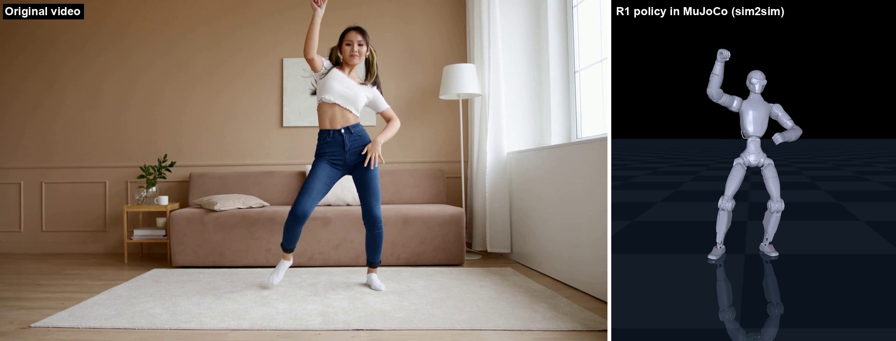
Fixed camera: video next to the R1
A fixed-camera reference example, 8.7 s
left: original video right: the R1 doing the same motion in MuJoCo
Notes:
**Time: 40 seconds, including the 8.7-second video.**
**Cue:** Play the video once. Point to the human on the left and the simulated robot on the right.
This is the fixed-camera reference example. The video goes through human-motion recovery, retargeting and policy training, then the trained policy runs in plain MuJoCo. I am showing the final delay-trained policy under nominal conditions. The side-by-side view helps me inspect the sequence and timing. It does not supply a ground-truth three-dimensional human pose.

Slide 9
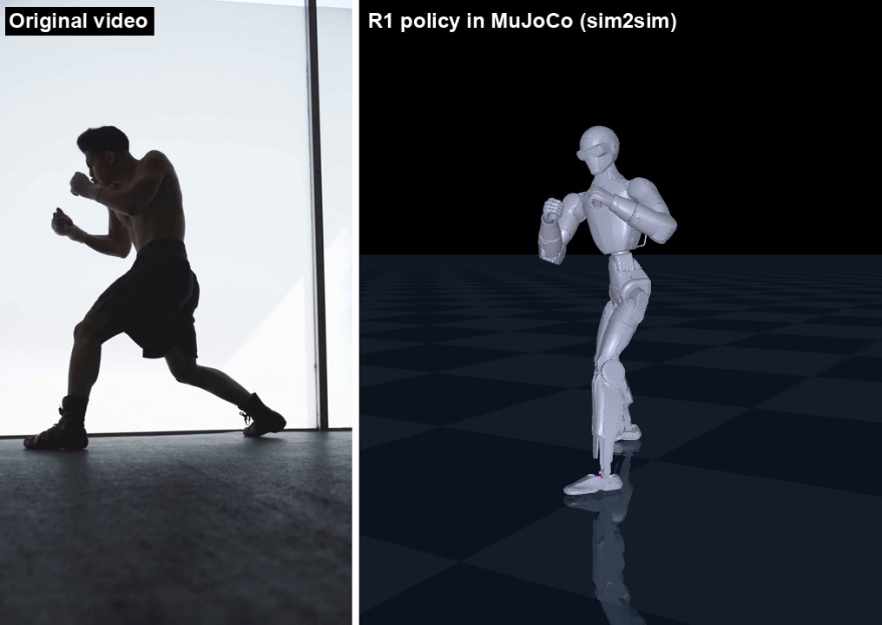
Moving camera: boxing
Camera follows him; the weakest of the three
left: original video right: the R1 (simulation)
Notes:
**Time: 45 seconds, including the 15-second video.**
**Cue:** Play the video once. Draw attention to the moving viewpoint and the wide stance.
Here the camera follows the boxer. The pipeline still produced a motion that the R1 policy could perform in simulation. This was the least robust of the three under strong pushes and low friction. In the retargeted reference, each ankle roll reaches its limit in more than half the frames. That could contribute to the difficulty, but I have not changed the ankle constraint and repeated the experiment, so I cannot claim it is the proven cause.

Slide 10
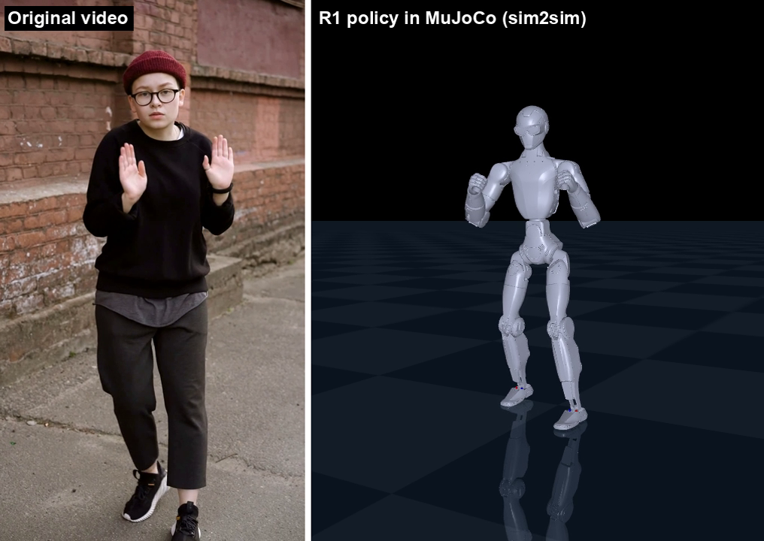
Moving camera: street dance
Handheld shake
left: original video right: the R1 (simulation)
Notes:
**Time: 40 seconds, including the 15-second video.**
**Cue:** Play the video once. Point out handheld camera motion while the robot completes the sequence.
The third clip uses a handheld camera. It also completed the pipeline and produced a policy that transfers to plain MuJoCo. This extends the examples beyond a fixed-camera tennis serve. It does not establish that the method works for every handheld video, severe occlusion, multiple interacting people or camera cuts. Those would require additional tests.

Slide 11
Did the robot survive in a second simulator?
Survival out of 20 runs in plain MuJoCo, before -> after delay training
Test
woman (fixed)
boxing (moving)
street (moving)
training randomization (of 30)
30 -> 30
29 -> 30
29 -> 29
+20 ms delay
20 -> 20
17 -> 19
17 -> 20
+40 ms delay
0 -> 20
0 -> 19
1 -> 19
+60 ms delay
0 -> 16
0 -> 13
0 -> 14
3x pushes
15 -> 18
5 -> 7
3 -> 8
slippery floor
15 -> 15
2 -> 3
14 -> 18
All three motions transferred: 29 to 30 of 30 trials survived the normal training randomization. At 40 ms delay almost nothing survived without delay training and almost everything did with it, on fixed and moving cameras alike.
Notes:
**Time: 70 seconds.**
The table compares the policy after the first training stage with the policy after an additional delay-training stage. Each motion has its own policy. Under the usual training randomization, twenty-nine or thirty of the thirty trials survived. At forty milliseconds of added delay, the fixed-camera dance changed from zero to twenty surviving trials, boxing from zero to nineteen, and street dance from one to nineteen, each out of twenty. The sixty-millisecond tests improved too, but not every trial survived. The boxing policy remained vulnerable to strong pushes and a slippery floor. These are robot-survival measurements, not measurements of human-pose reconstruction accuracy.

Slide 12
What this does not show
The honest slide
Each clip got its own newly trained policy, with 3,000 extra training iterations in the delay stage. Only the earlier tennis test, with three seeds and a no-delay control, separates delay training from extra training.
Three different clips with three different cameras cannot isolate the effect of the camera.
I have no true human pose for these stock clips, so robot tracking error is not a measure of how well GVHMR reconstructed the person.
Boxing is weakest. Its reference holds both ankles at their limits most of the time, which is a likely explanation, not a tested one.
One seed per clip. Simulation only. No hardware.
GMR assumes 30 fps. My earlier dance clip was retargeted 1.2x too fast; the new clips use their real frame rates.
Notes:
**Time: 70 seconds.**
There are several limits I want to keep clear. The delay stage also adds three thousand training iterations. This table alone cannot tell me whether the improvement came from delay exposure or simply more training. The earlier tennis study used matched extra-training controls and three training seeds to separate those effects. Here I have only one training seed per clip. Also, different motions with different camera conditions do not isolate the camera effect. I do not have ground-truth human poses for the stock clips. Finally, I found that the earlier twenty-five-frame-per-second dance had been treated as thirty frames per second, so its robot motion ran one-point-two times too fast. These new clips use their source frame rates.

Slide 13
PART 2
Making the simulator more real
using data from the real R1 in the lab
a plan this week -- the safety gantry has not arrived, so nothing runs on the robot yet
Notes:
**Time: 15 seconds.**
My second topic is a proposal for using data from our real R1. This week I am presenting the approach. I have not run a new experiment on the physical robot, and I will not do that while the gantry is unavailable.

Slide 14
Why I need real data
My policies are only as good as the simulator they train in
Command delay is the clearest example: at 40 ms the policy trained without delay mostly falls, while the delay-trained one survives. I picked those delays; I have not measured the real robot's.
The lab robot is an R1 EDU light version with non-dexterous hands. The SDK and logs are available.
Prof. Sun does not recommend testing it in person until the safety gantry arrives, so I will not run anything on it yet.
The official SDK example is not a passive logger: it takes over the robot's motion service and publishes commands. I will not run it unchanged.
Notes:
**Time: 45 seconds.**
Delay is the clearest reason to measure rather than guess. I tested chosen delay settings in simulation, but I have not measured the real robot's command-to-motion delay. Our lab robot is the R1 EDU Light with non-dexterous hands, and its SDK and logs are available. Prof. Sun advised waiting for the gantry before testing in person. I can still inspect existing logs offline. I also checked the official SDK example: it takes control and sends commands, so it is not something to run unchanged just to read sensor data.

Slide 15
The approach I propose
Measure first, then tune the simulator, then check on motions it has not seen
1. Start with logs
2. Fit
3. Check
4. Use
use the logs that already exist now; record new timestamped joint data and commands only after the gantry arrives
the delay, how fast each motor responds, and its limits and friction
predict a motion I did not use for fitting and compare it with the recording
put the measured ranges into the training randomization
A learned actuator model is a later option, if the simple fit still leaves a systematic gap. Things to confirm first: the joint mapping (the SDK example lists 26 joints with the head; my simulation controls 24), and that estimated torque is not ground truth and a body sensor (IMU) alone does not give a drift-free base velocity.
Notes:
**Time: 65 seconds.**
First I would inventory the existing logs: which joint states, IMU signals, commands and timestamps were recorded, and whether they share a synchronized clock. Then I would fit the behavior the data can actually identify, starting with delay and motor response. I would keep some recorded motions out of the fitting process and use those to check the prediction. If the model predicts those held-out motions better, I can use measured parameter ranges in simulation and randomization. Existing logs may not contain enough commands or excitation to identify every parameter. Estimated torque is not a calibrated torque measurement, and an IMU does not directly give drift-free base velocity. Any new collection stays deferred until testing is permitted.

Slide 16
PART 3
A bag of R1 skills
train single actions, then chain them in a MuJoCo game I steer myself
walk, run, jump, kick, punch, grab -- each trained separately through my pipeline
Notes:
**Time: 15 seconds.**
My next series is a library of separately trained skills. Instead of ending at a single motion demonstration, I want to connect the skills and control the robot in a MuJoCo game. The first complete milestone is a fluent walk, run and jump sequence.

Slide 17
The idea
A school scene in MuJoCo, and the R1 gets from one point to another with the skills in the bag
One policy per skill
A switcher
A game
Each skill is a motion video or mocap clip, retargeted by GMR and trained as its own policy. Each is one item in the bag.
I pick the skill, the switcher blends from one policy to the next.
A school scene in MuJoCo. I steer the R1 and it uses the skills to travel between points.
First milestone I set: connect walk, run and jump fluently, as one chain.
Notes:
**Time: 45 seconds.**
Each item in the bag contains a trained policy and the information needed to run it: its reference motion, joint order, control settings and entry and exit conditions. The game sends my movement and action choices to a controller that selects the appropriate skill. The controller must keep the robot's state continuous during a switch. The school scene is the setting for the challenge, but the main technical result is the robot moving between points with connected skills. Kick, punch and object handling remain later extensions.

Slide 18
What already exists
I checked for similar work before designing anything
RoboJuDo switches between several trained policies with interpolation, supports BeyondMimic-style motion policies and keyboard control. Its published robot support is G1, H1 and GR1, not the R1, so it is a reference to adapt, not a drop-in.
ASE and DeepMimic are the classic multi-skill and hierarchy references. DeepMimic's own motion data includes walk, run, jump and punch for its simulated humanoid, and its README now points to MimicKit. Neither gives a ready policy for the R1.
A 2026 paper, Switch, trains one tracker on skill transitions and switches skills on a G1 humanoid. It is the paper I present next.
No verified R1-ready walk, run and jump switching package was established in this review.
Notes:
**Time: 45 seconds.**
I searched for work I could reuse before designing a new framework. RoboJuDo is a useful reference because it separates the input controller, policy and simulator and supports switching between locomotion and motion-imitation policies. Its documented integrations do not establish an R1 drop-in for this project. ASE provides a reference for reusable skills and higher-level control. DeepMimic already includes humanoid jump, punch, walk and run motion examples, and its repository now points to MimicKit. The gap I need to address is integrating suitable R1 policies and testing the full walk-run-jump chain, not inventing the existence of these actions. One 2026 paper, Switch, deals directly with switching between skills, and the next slides present it.

Slide 19
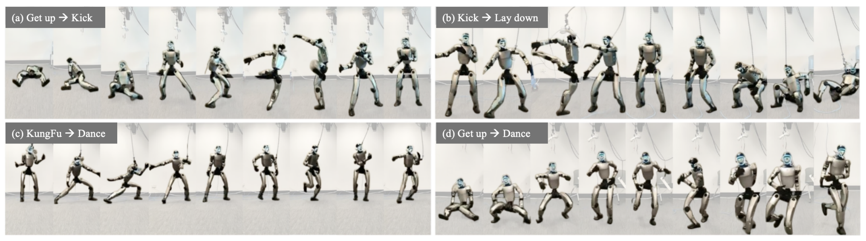
A paper for this idea: Switch
Learning Agile Skills Switching for Humanoid Robots
Figure 1 of the paper: the authors' G1 robot switching between skills. Source: Lau et al., arXiv 2604.14834.
The paper
Why I picked it
Yuen-Fui Lau, Qihan Zhao, Yinhuai Wang, Runyi Yu, Hok Wai Tsui, Qifeng Chen, Ping Tan. HKUST. April 2026 preprint. Unitree G1 humanoid.
Connecting my walk, run and jump skills is my next challenge, and this paper is about exactly that. I present their work, not an experiment of mine.
Notes:
**Time: 20 seconds.**
I picked Switch because it addresses the part of my next project that I expect to be hardest: connecting skills fluently. This is an April 2026 preprint by Yuen-Fui Lau and collaborators. I am presenting their work as a reference for my R1 project. These are their results, not experiments I ran.

Slide 20
Introduction and summary
Skills that work alone can still fail at the handoff
The problem they see
What Switch does
My connection
Whole-body controllers can now do agile single skills. Switching between two of them is still unreliable, because the controller never trained on the states that appear during a switch.
Three parts: a skill graph that links similar moments of different skills, one tracking policy trained on those links, and an online scheduler that picks the path to the skill you ask for.
A bag of three good clips is not a chain. I should judge my R1 on the connected rollout, not only on walk, run and jump shown separately.
Notes:
**Time: 45 seconds.**
My idea starts with a bag of motions. But three successful demonstrations do not automatically give me one successful chain. Switch combines a skill graph, a transition-trained tracker and an online scheduler. I find that useful because it treats the handoff as something to design and test. For my project, I would judge the connected rollout rather than only show walking, running and jumping in separate videos.

Slide 21
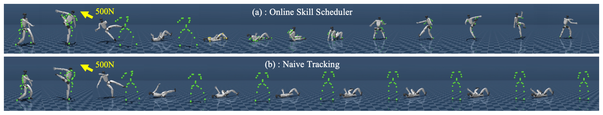
Core challenges
Why switching fails, and what plain tracking does after a push
Figure 3 of the paper (their simulation): a 500 N push knocks the robot down. Top: with the scheduler it gets up and resumes the kick. Bottom: plain tracking stays down.
Unseen transition states
Too many pairs
No recovery plan
The controller fails when it meets states it was never trained on, such as the moment between two skills.
Recording every possible transition between every pair of skills grows too fast as skills are added.
A fixed reference has no explicit recovery plan after a large deviation, even though the low-level tracker still reacts to feedback. For me: a jump has to start from the state the run leaves, and a bad landing needs a recovery.
Notes:
**Time: 45 seconds.**
A switch changes what the controller is asked to do while the robot is already moving. The next policy receives the actual pose, velocity and foot contact left by the previous action. It cannot assume a reset to a convenient training pose. The paper identifies mismatched states and unfamiliar transitions as key difficulties. In my game, pressing jump during a run should lead to a feasible takeoff, not an instant change into the first frame of a jump clip.

Slide 22
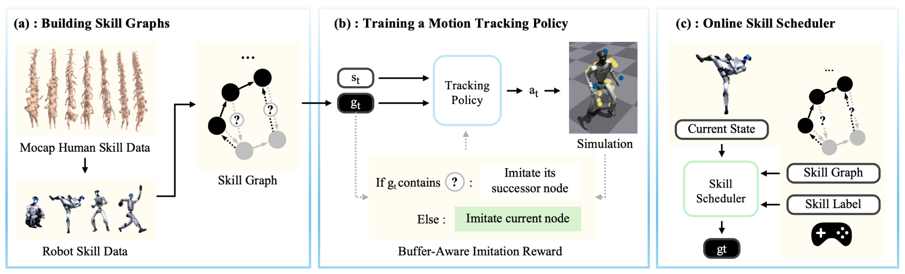
Framework
Three steps: link similar states, train on the links, plan online
Figure 2 of the paper (Lau et al.).
a. Build a skill graph
b. Train one tracker
c. Schedule online
Each motion frame is a point. Similar frames of different skills get a link, with extra buffer frames where the gap is large.
The policy practices the linked transitions in simulation, with a reward that guides it through the buffer frames.
From the robot's current state, the scheduler finds the path to the commanded skill. The hardware runs the simpler nearest-neighbor variant.
Notes:
**Time: 60 seconds.**
I read this figure like a route map. The graph connects similar motion states; training includes transition buffers; the scheduler selects the next reference online. The paper's hardware uses its nearest-neighbor scheduler variant. The useful idea for me is that selecting a destination skill is different from choosing a path into it. I would need to check whether my R1 can execute those handoffs, rather than assume that a visually smooth reference is physically stable.

Slide 23
Results (the authors' numbers)
Skill switching success in their MuJoCo test, % of 50 trials
Method
1 switch
2 switches
3 switches
Base (trained on single skills)
2
2
2
GMT (general tracker)
30
10
2
Base + skill graph
100
100
100
Base + skill graph + buffer frames
100
100
100
Full Switch (+ foot contact reward)
100
100
100
Whole-body position error, Switch vs GMT (m, Table II): 0.075 vs 0.396, 0.090 vs 0.491, 0.098 vs 0.588 for 1, 2 and 3 switches.
Policies trained in IsaacGym, tested in MuJoCo, four skills, 50 trials per difficulty. A trial counts as failed if the root-relative average body position error passes 0.5 m at any point. Fifty evaluation trials are not fifty training runs. The buffer frames and contact reward cannot raise a column that is already at 100, and some velocity and acceleration errors did not improve. These are their results, not mine.
Notes:
**Time: 60 seconds.**
This is a summary of the authors' MuJoCo table, with fifty evaluation trials per difficulty. The difficulties require one, two or three switches. The graph-trained variants reach one hundred percent success in these tests. That does not prove universal reliability, and fifty evaluation trials are not fifty independent training runs. The buffers and contact reward cannot raise a success column already at one hundred percent, so I should not credit every component with that gain. I would want the same discipline in my own results: define success, show the baseline, and inspect the failures.

Slide 24
Core values for my project
What I would take from it, and what it does not show
What I would use
What it does not show
How it differs from my plan
Treat the handoff as part of the experiment. Compare plain switching with a transition-aware controller, measure whether the complete walk, run and jump chain succeeds, and look at the failed landings. These are experiments I propose; none has been run.
Their robot is a G1, not the R1. Skills they show include kicks, Kung Fu, dance and getting up, not my walk, run and jump. Their 100% belongs to their tests. I did not find an author code release.
Switch trains one tracker on the transitions. My first idea was one separate policy per skill. Separate policies stay as a baseline to compare against, and a shared tracker is the fallback if switching them fails.
Notes:
**Time: 45 seconds.**
My takeaway is to make transitions part of the experiment. I would compare direct switching with a transition-aware controller, keep the robot's state continuous, and measure whether the complete walk-run-jump chain succeeds. Switch uses a unified tracker, which differs from my initial independent-policy plan. Its G1 work does not establish the R1 result I want, and I have not verified an author code release. It gives me a method to study, not a completed game to download.

Slide 25
Why fluent is harder than it sounds
Three tracked clips are not a game
A policy that tracks one walking clip does not walk in an arbitrary direction or speed. The game needs a walk I can steer.
Switching needs the end of one skill to match the start of the next: matching speed, heading, and a stable posture.
Jumping adds a landing, so the switcher needs a recovery path when a landing goes wrong.
Grabbing adds hands and objects, which my pipeline does not handle yet. It comes last.
Notes:
**Time: 60 seconds.**
Three independent policies can each look good and still fail when connected. A walk clip does not automatically become a controller that follows my chosen heading and speed. At a switch, the next policy receives the position, velocity and contact state left by the previous one. It must handle that state instead of restarting from its training pose. Running into a jump also needs an appropriate takeoff phase, then a stable landing and return to locomotion. I will judge fluency from the actual connected rollout: no reset, no teleport, no fall, and no large movement discontinuity. That is the milestone; simply loading three policy files is not enough.

Slide 26
Next
My plan, in order
1. Walk and run
2. Add jump
3. School scene
Train a steerable walk and a run, and make them switch cleanly. Walk to run first.
Add jump with a landing and a recovery, then check the whole chain in a plain MuJoCo scene.
Build the school scene and steer the R1 from one point to another. Calibrate the simulator with real R1 data when the gantry arrives.
Notes:
**Time: 45 seconds.**
I would develop the milestone in stages. First I would establish controllable walking and running and test their transitions. Then I would add a jump that can start from locomotion, land and continue moving. Those stages together complete the first milestone; I am not dropping the jump requirement. After the chain works in a simple scene, I would add the school layout and test reaching points using the same controls. In parallel, I can review existing lab logs offline. Physical measurements stay deferred until the gantry arrives and Prof. Sun permits testing.

